Slide 1
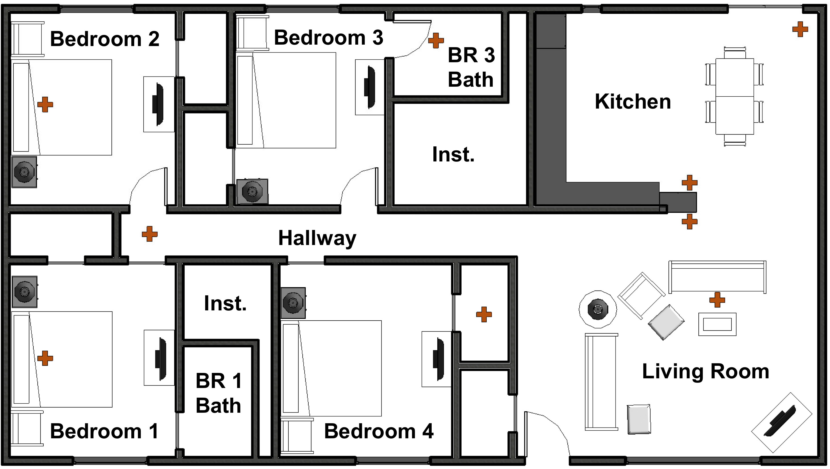
Measurement matrix

Slide 2
Kitchen/Living room burn (Sept 29)

Slide 3
Bedroom burn (Oct 4)

Slide 4
Kitchen/Living room burn (Oct 5)

Slide 5
Bedroom burn (Oct 9)

Slide 6
Kitchen/Living room burn (Oct 10)

Slide 7
Bedroom burn (Oct 20)

Slide 8
Kitchen/Living room burn (Oct 21)

